Slide 1
Infrastructure Investment –Streetworks and Permitting
Angela Jones, Director of Thriving Places

Slide 2

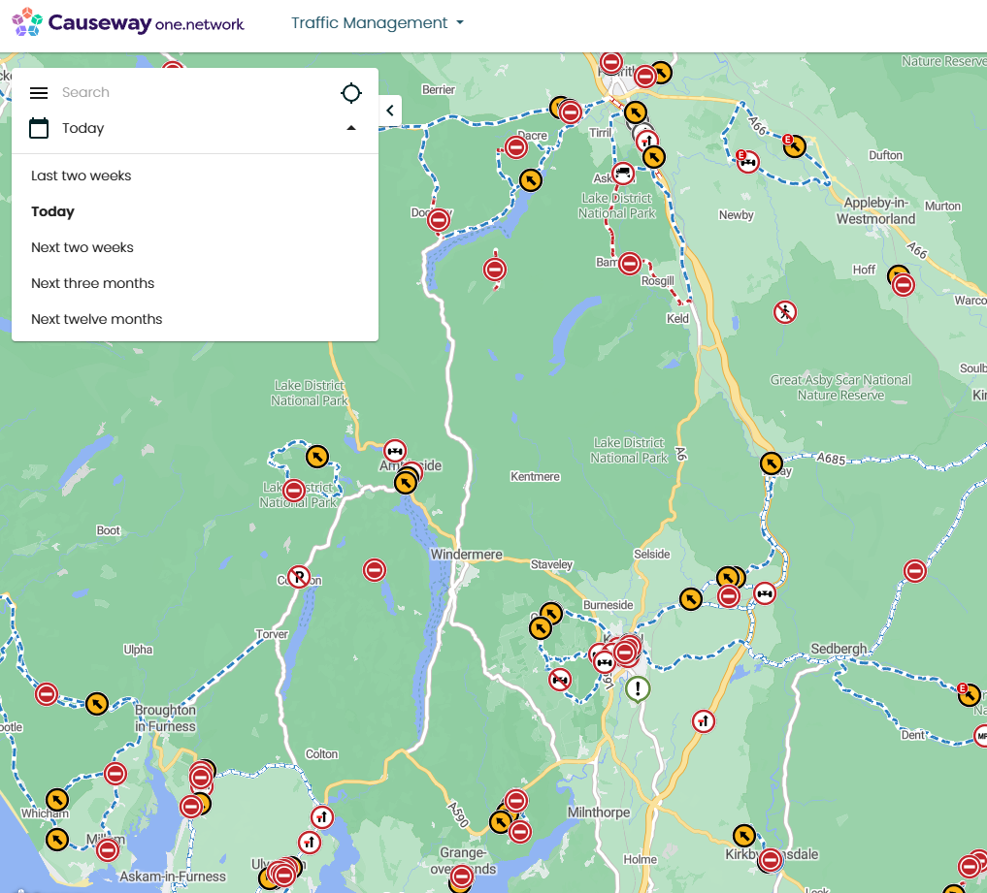




Purpose
To provide a summary of the infrastructure investment in W&F and its impacts on the highway network.
To highlight the legislation and streetworks permit schemes, rights of utility companies and others to undertake streetworks and the powers available to highway authorities to manage and mitigate those works.
Live Road Works Map
FAQ’s

Slide 3
Investment in Infrastructure

Slide 4
Investment in Rural Areas
For decades Local Authorities have been campaigning for public and private sector investment in rural infrastructure, such as Broadband, Electricity, Highways, Bridges, Water Treatment to name a few.
Over the last few years Cumbria has secured £hundreds of millions in infrastructure investment - both through Government funding and private sector/commercial investment.
This funding and investment has been welcomed, however it now creates a new challenge of significant disruption on the rural highway network, impacting on businesses, residents and visitors.
The following slides provide some examples of the investment

Slide 5


Broadband Connectivity
Digital infrastructure is now recognised as the fourth utility given its importance to modern life and the connectivity it provides to services and markets. Whilst significant improvements have been made through the Connecting Cumbria programme, continuing to improve our digital connectivity will be essential over the coming years so that Cumbria does not get left behind other parts of the UK. This includes the need for investment in full fibre and mobile infrastructure to support economic growth, education and social inclusion.
Commercial Roll out – there are many network operators provide residents and businesses access to full fibre and gigabit capable broadband services in Cumbria.
Cumbria is the pilot area in the UK Gigabit Programme and has been allocated a budget of up to £109m to extend gigabit capable connections to some of the hardest to reach premises that won’t benefit from commercial deployments.
Alongside wider commercial roll-out, Fibrus has started work to connect tens of thousands of people living and working in rural Cumbria to high-speed connectivity as part of a £108 million government UK Gigabit Programme contract.
https://connectingcumbria.org.uk/home-page-2
Find out more about the Project Gigabit rollout at www.hyperfastgb.com,

Slide 6

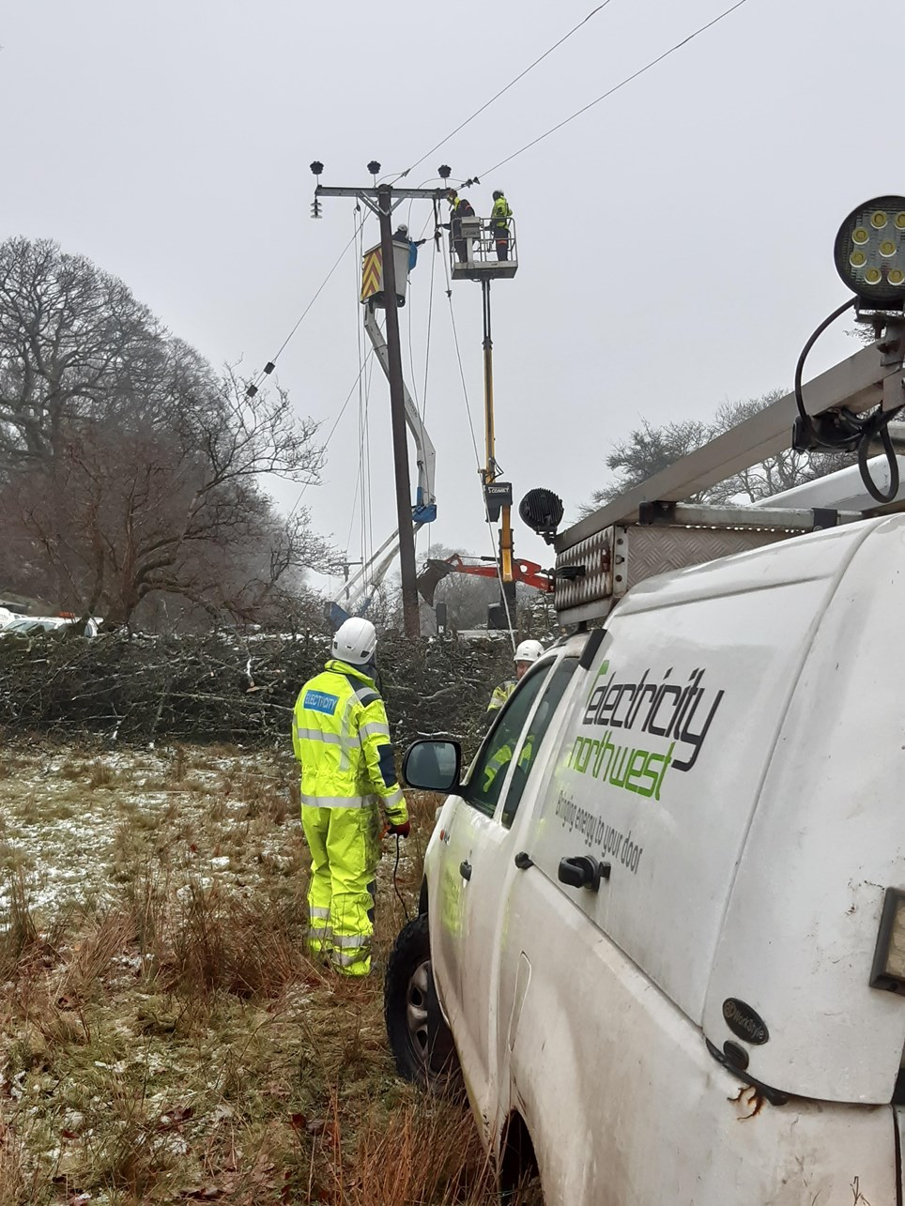

Electricity North West – Resilient Network
Electricity North West is two years into a record £2b five-year investment programme, and its latest plan sets out the need for an additional £200m investment over the next three years.
Storm Arwen investment – following Storm Arwen Electricity North West will spend an extra £40 million over four years across six projects to make the power network more reliable during bad weather in some of the region's most remote areas, including Cumbria.
Electricity North West is embarking on the largest ever investment in the North West's power network, including the £40m Cumbria ring project. It is their biggest ever investment in Cumbria and will see the replacement of 154km of 132kV overhead line on the Cumbria Ring.
Electricity North West is investing £500,000 to upgrade the power network which supplies electricity to more than 4,000 customers in Ambleside, Cumbria.

Slide 7

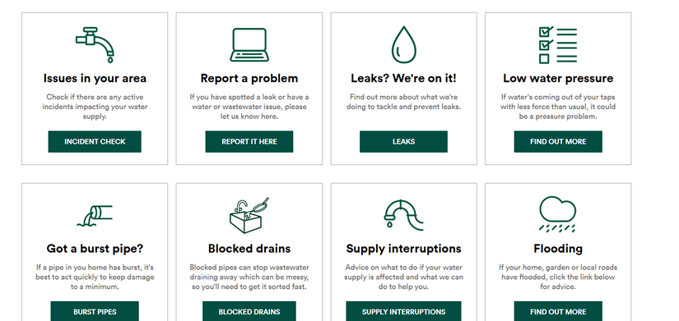
United Utilities
A £1.5 billion programme of accelerated investment which United Utilities is starting over the next two years, aimed at creating cleaner rivers and lakes and more reliable water supplies
A multi-million pound package of investment at four sites around the lake Windermere: Hawkshead, Near Sawrey, Elterwater and Ambleside.
Funding for upgrades to the Coniston WwTW
Strategic drainage plans and investment, including on highways to reduce the risk of flooding and better surface water management.
New water supplies to properties – businesses and residents
Repair and maintenance of the water mains and drains
https://www.unitedutilities.com/globalassets/documents/pdf/windermere-booklet.pdf

Slide 8

Gas
£80m investment 24/25 to modernise the North West gas network.
Older assets is reaching end of safe working life, increasing disruption repairing faults.
Cadent, which manages the region’s gas network, will modernise around 420,000 metres of its North West pipeline over the 12 months to 31st March 2025.
Replacing and upgrading vital pipes to plastic to ensure a long-term safe network, as well as remain on track to replace fossil gas with greener alternatives, such as biomethane and hydrogen.
This change is essential to achieve local plans for meeting energy demands in Cumbria.

Slide 9
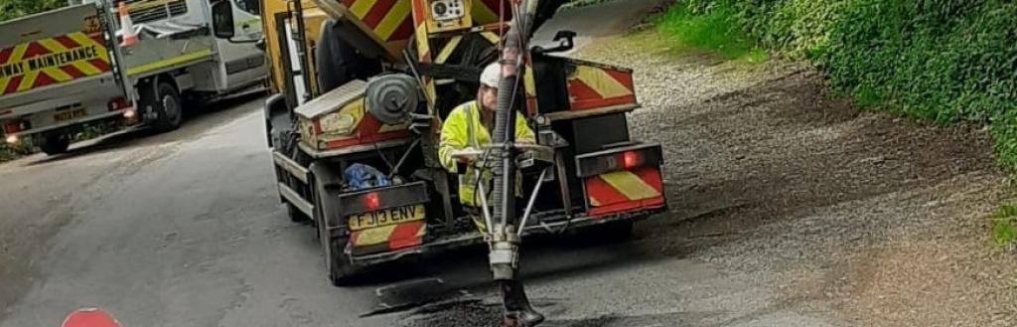
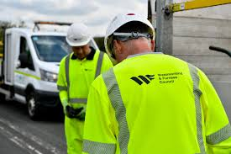
Highways Investment
The highway network in Westmorland and Furness is an ageing asset and is affected by extreme weather events, which are becoming more regular.
Westmorland and Furness circa investment in 25/26
Nationally more roads are falling into disrepair despite an increase in road surfacing this year compared to last.
Try to avoid working on the network during school holidays in popular tourist areas. Not always possible!
.

Slide 10
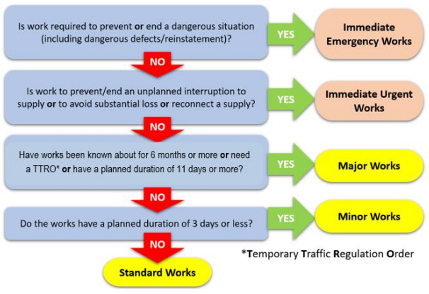
Emergency or Urgent Activity
Ageing infrastructure – electricity, water, gas, highways, broadband. Results in more urgent repairs, need for reconnection and maintenance.
Emergency activities are where there in an immediate danger or likelihood of danger to life. Immediate Urgent is defined in legislation
Immediate activities do require a permit, although because such activities are concerned with emergency or urgent situations, the work can start before applying for a permit (a permit is required within 2 hours of work start).

Slide 11
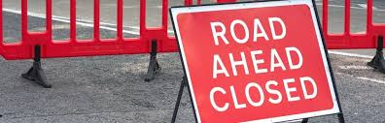
What does this mean?
All of the investment is vitally important and welcomed
BUT….
Significant work on the highway network by multiple utility providers, W&F Council and National Highways
Co-ordination is challenging
Narrow roads often mean road closures, rather than traffic management
Long and unsuitable diversion routes
Disruption to local communities and businesses
Emergency or Urgent Works that are not able to be planned often add to disruption.
Adverse weather makes the work challenging in colder/wetter months with less daylight and when the weather is warmer and more daylight hours there are more visitors/road users.

Slide 12
Permits and statutory undertakers

Slide 13
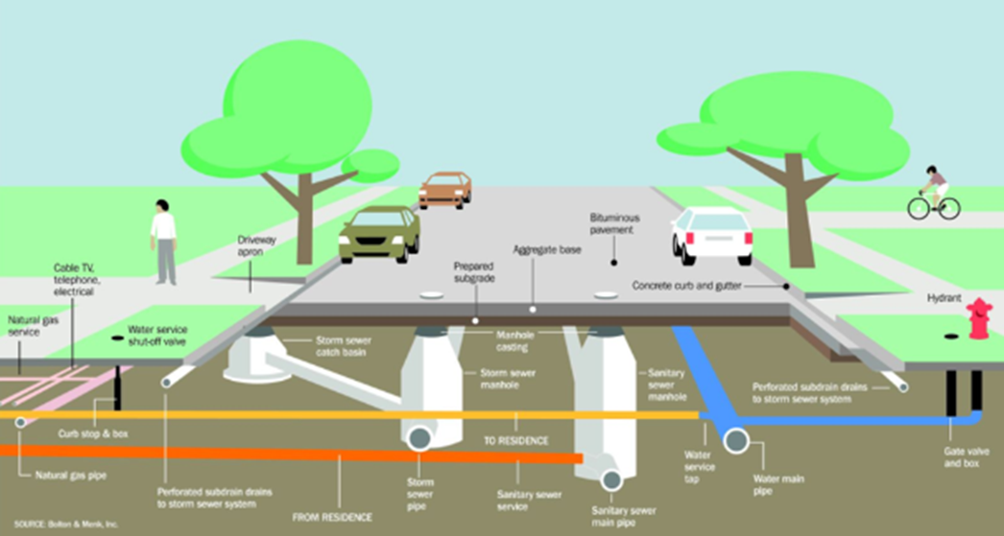
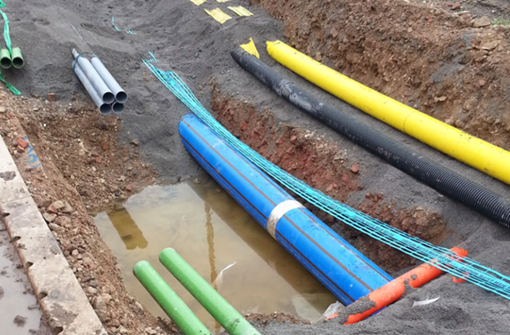
Who can work on a road?
Certain companies or public bodies have a legal right (under the New Roads and Street Works Act) to dig up roads in order to install new pipes, cables, etc, or to maintain their existing ones. These are known as statutory undertakers.
In general, these are companies that supply water, gas, electricity and telecommunications, etc.
Most of the statutory undertakers do not carry out their works themselves but use contractors to do the work. The contractors should display a board saying who they are, who they are working for and giving a contact phone number.

Slide 14


Permits Scheme
Westmorland and Furness operates a Permit Scheme in line with the Traffic Management Act 2004, giving powers to Highway Authorities to require all highway works to be permitted.
Permits are required for most work in the road or pavement that takes place on any publicly maintainable highways.
Permissible works include such things as:
street works - work on plant and apparatus in the street by undertakers (utility companies or contractors)
works for road purposes - maintenance and improvement works to the road itself carried out by, or on behalf of, the highway authority
major highway works

Slide 15
Objectives of Streetworks and the Permit Scheme
Significantly improve coordination by providing a structured and regulated framework for managing activities
Aims to reduce safety hazards and incidents, minimise adverse impact of works on residents and/or businesses, disabled people and/or public transport users
Targeted work to help delivery of national infrastructure projects
Protection of the structure of the street and apparatus within it, in a way that helps manage long-term maintenance costs
Better information for road users about works in the highway
Ensure compliance with highways legislation by utility companies
Improving cooperation and collaboration between different utility companies
Promoting adoption of minimally invasive works methods, and measures to mitigate the impact of excavations
Reduction in the environmental impact of works (less noise, greater cleanliness, more recycling of materials etc.)
Permit fees and defect charges designed purely for cost recovery which covers employment of different personnel to process permits, monitor works, enforce regulations and inspections alongside administrative expenses such as IT systems, software and hardware

Slide 16
What does the permit scheme allow?
A streetworks permit scheme aims to minimise disruption from road and street works by requiring companies to obtain permits before undertaking any work on the highway.
The permit scheme allows the council to require work to be carried out at specific times and to apply conditions as to how this work is to be carried out. Because the scheme covers its costs the council has more oversight which is funded by those causing the potential disruption rather than the taxpayer.
Any utility companies or contractors acting on behalf of either a utility company or a local authority must apply for relevant permits. While it might seem odd to be issuing permits for our own works, it is a legal requirement that parity exists across all permit applications and the processes surrounding them, regardless of who is making the application. In addition the full picture is needed for coordination of works.
Can we take enforcement action?
If a works promoter breaches the conditions of a permit, they may be issued with a fixed penalty notice. The aim of this is to improve compliance and reduce the disruptive impact of streetworks.
A penalty of £120 is applied, which will be doubled as of Summer 2025. These are set by central government.
FPNs can be issued for several reasons such as:
Late start/stop of a permit
Late registration
Breach of permit conditions
Incorrect registration details
Incorrect permit details
Working without a permit (a higher charge of £500 is issued)

Slide 17
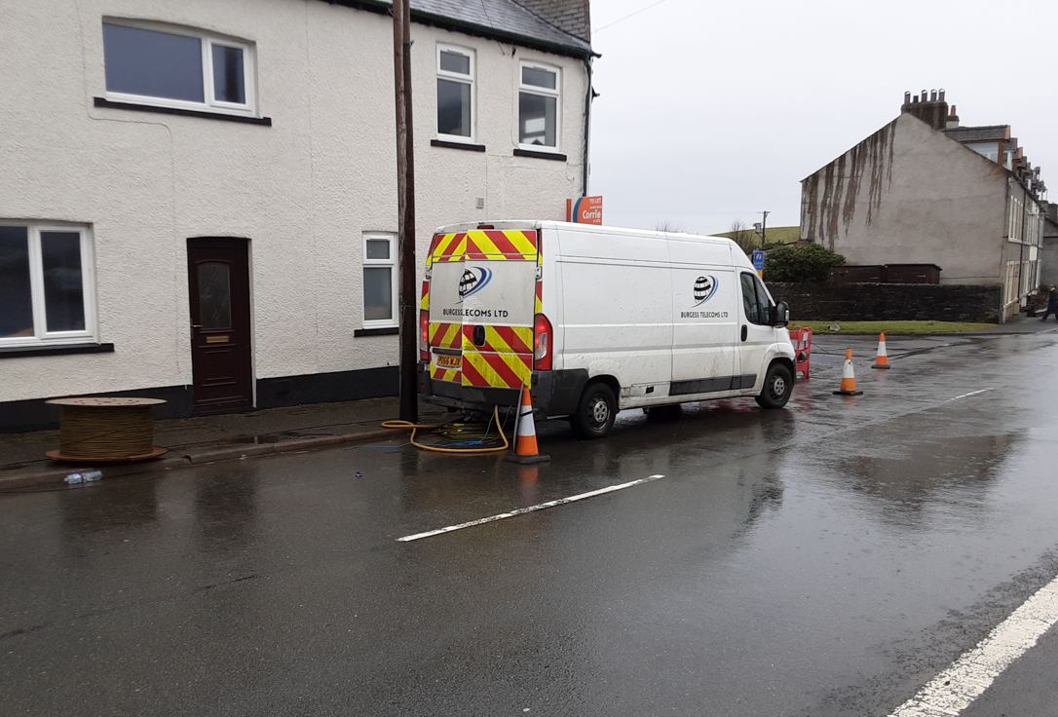
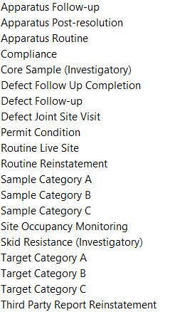
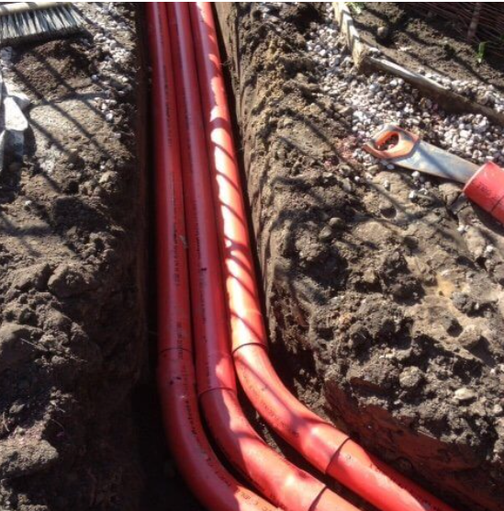
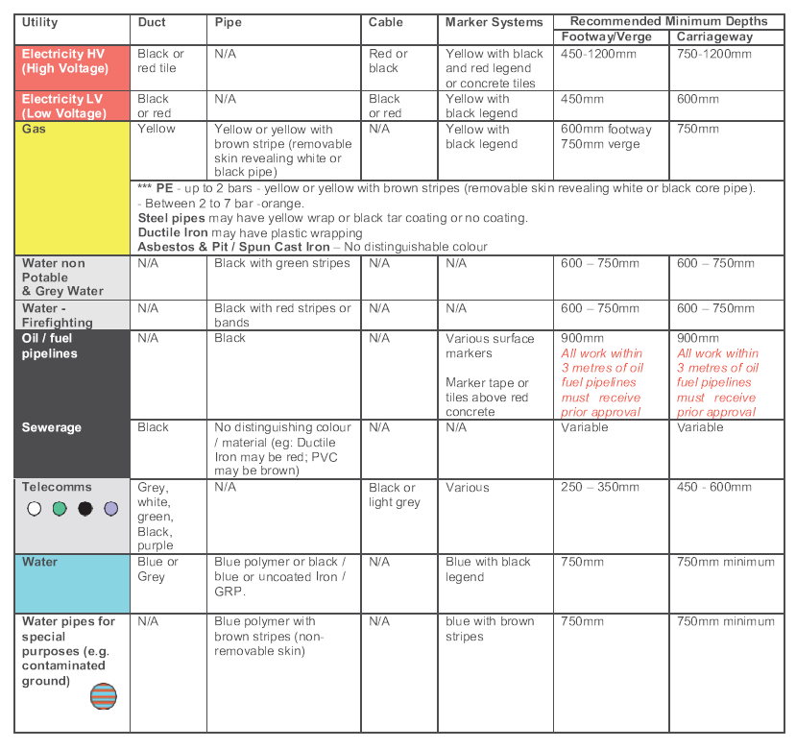
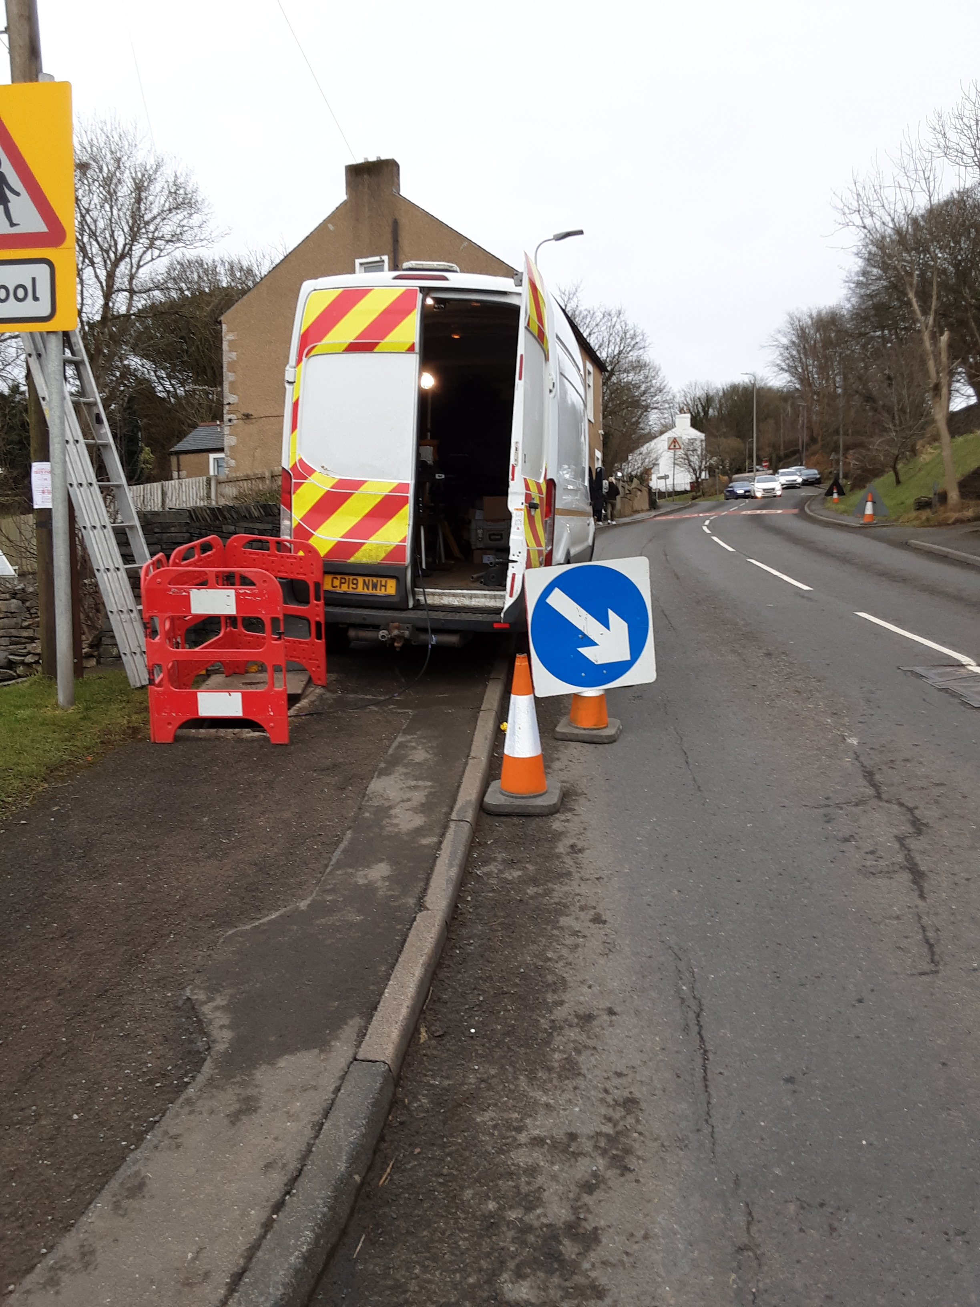
Compliance inspections, Cat A (in progress works)
SLG – pedestrian provision and TM
What happens below is also important
Depth of apparatus, compaction and depth

Slide 18
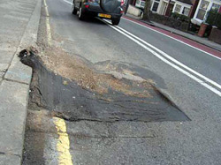
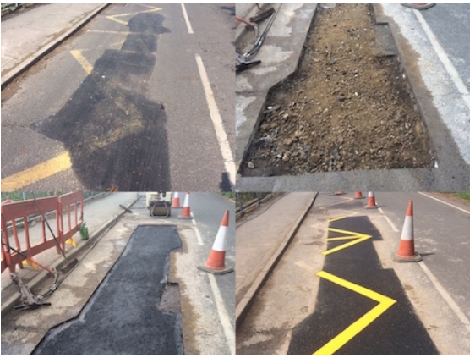
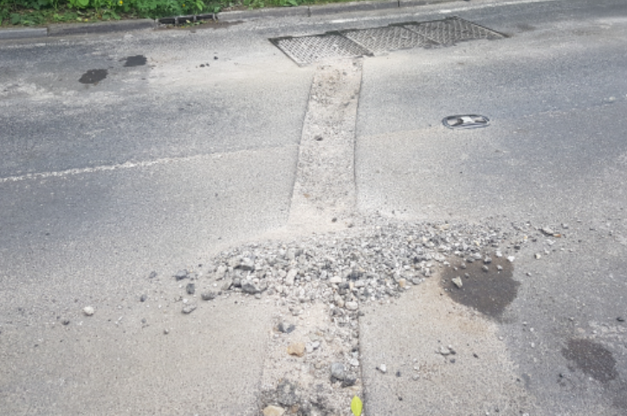
Compliance, post works reinstatement: Cat B (within 6 months of reinstatement) Cat C (months 22,23 & 24 or 34,35 & 36 for deeper excavations)
Material, compaction and layer depth; all important aspects
Reinstatements and excavation; defects when not done correctly

Slide 19
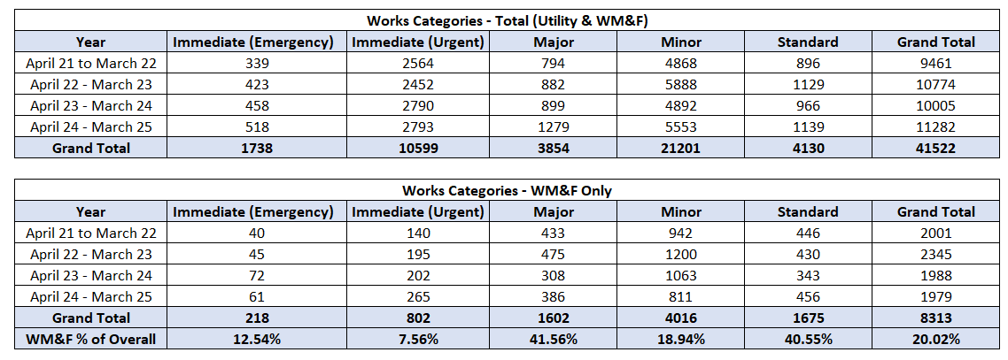
Numbers – permits & TTROs
This will increase 25/26 based on programmes
Measures being put in place to try and reduce; co-ord, TM, duct share, innovation, duration, site meet

Slide 20
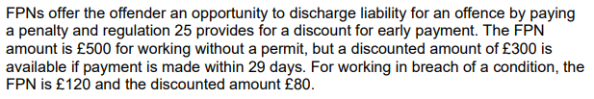
Details on inspections and or FPNs
More inspectors being brought in to cope with demand
Additional training in the pipeline to ensure competencies in all aspects of streetworks are adhered to
Working with utilities to strive for right first time
These penalties set to rise, possibly double

Slide 21



Can the Council insist on joined up working?
The council has a duty to co-ordinate the work of statutory undertakers, but we can't force them to work together. We hold co-ordination meetings with teams responsible for road maintenance and new projects together with representatives of the statutory undertakers/utility companies.
Telecommunications companies carry out much of the work in W&F. This is a highly competitive business. Not surprisingly some companies are reluctant to reveal their forward plans, beyond their legal obligations.
Some works cannot safely take place together and sometimes due to the location of each company’s equipment in the street and the space they need to occupy to let them work together would be more disruptive.
The council has been successful in persuading some companies to work together and lay several cables in one trench, but it can only persuade, it cannot force them to do it.

Slide 22
Live road works map

Slide 23

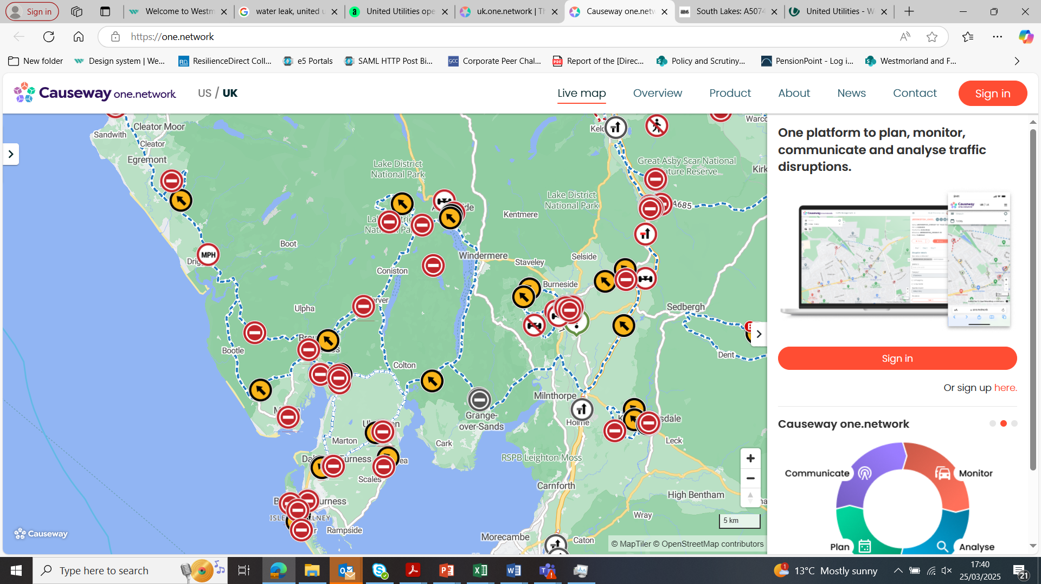
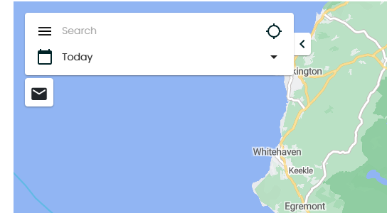
Road works live map
The Causeway one.network Map is the UK’s single source of truth for information about traffic disruptions, displaying comprehensive information about current and planned roadworks, public events and traffic management interventions such as road closures and diversion routes.
User friendly and free-to-view, Causeway one.network is one of the most visited, most comprehensive and most widely syndicated source of roadworks and traffic disruption information in the UK.
The road works map on our Westmorland and Furness website is provided by one.network.
Access can be via the council website or to one.network directly.

Slide 24
FAQ’s

Slide 25
Why does the council allow utilities to dig up the roads so often and during school holidays?
We cannot stop a statutory undertaker digging up the road. They have a legal right under the New Roads and Street Works Act, to maintain their existing pipes, cables, etc, or to install new ones.
There is a lot of infrastructure investment in W&F and this is creating pressure and disruption on the network. W&F try to avoid planned work in holidays in popular tourist areas.
We cannot force utility companies to undertake planned work only in school holidays where it would suit us better as well. We can try to persuade them and work hard to collaborate.
Each request is considered individually, because in some cases it is less disruptive to undertake works inside school holidays and in others, such as popular visitor areas, it is less disruptive to avoid the holidays.
Our teams are familiar with local areas and pressures and work hard to coordinate works taking into account local factors wherever possible.
There is a constant dialogue between works promoters and the streetworks team. Communication is requested and encouraged at every opportunity.

Slide 26
Why doesn't the council tell Members and residents their road is about to be dug up?
Although it might seem like a good idea for the council to inform all residents, the volume of work on highways makes this impractical.
Over 10k permittable works are carried out each year in W&F by statutory undertakers alone. The vast majority of which are less than 3 days in duration. There are far more non notifiable works as well.
Under the permit scheme, the most disruptive and long-term works require notification to immediately affected residents and business. Direct notification is required to be undertaken by the applicant for the works i.e. utility company or Local Authority where it is council works. Major works require a permit application (and may also need a Temporary Traffic Regulation Order (TTRO) such as road closure) at least 3 months ahead to allow time for effective co-ordination and notification by the utility company.
Schemes involving traffic restrictions such as prohibitions of vehicular traffic (road closures) all require a Traffic Regulation Order (TRO) under the provisions of the Road Traffic Regulation Act 1984. Temporary Orders may be used when works affecting the highway require short-term traffic restrictions such as a road closure or temporary speed limit.
The Council must contact all statutory consultees of any temporary restrictions (TTROs). These include emergency services, Local Members and Town and Parish Councils. These are sent out via email approx. 3 weeks before the start date. These can be forwarded on and link to our online road works map which can be accessed by anyone because it is publicly available.
Email alerts can be set up on the Road Works system to notify of any upcoming works by clicking on the envelope symbol on the following site: Roadworks | Westmorland and Furness Council

Slide 27
Why do the works take longer than planned?
People have been digging holes in the road to lay pipes or cables for over 100 years. Records of what was done in the early days are poor or non-existent. But this is improving.
Although there are very sophisticated systems available to locate underground services, none of these are 100% accurate. Nobody can be certain of what’s in the ground until they start digging.
The geology presents problems. We know utility companies have to drill through rock in some places – and with the challenge of working in a National Park, the utility companies need to minimise the impact of their work on the environment.
The weather in Cumbria is not always conducive to work on a highway …. heavy rain, flooding, snow and ice can delay works.
Resource can also be an issue, especially in harder to reach areas. Then, getting the gangs to mobilise effectively from site to site seamlessly also poses some challenges, geography and long travel times.
Immediate (urgent or emergency) works may occur where the planned works need to be suspended.
All these things can combine to make work take longer than planned.

Slide 28
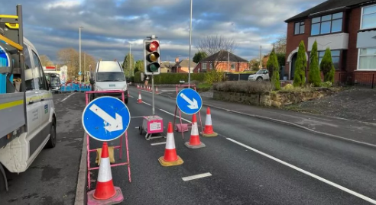
Why are there works but nothing happening on site?
When works take place, there can be multiple gangs involved in different parts of the task, each having their own specialism.
The utility applies for the permit, allowing for some flexibility for issues such as:
Vehicle issues
Resource issues
Weather
Geography of patch
Unforeseen underground issues when excavating
TM set up
Excavation
Engineers
Unbound material
Tarmac
What are we doing about it?
W&F streetworks are:
challenging durations
pre works on site meetings
ensuring legislative lead times are applied
asking for collaboration amongst internal and external works
scrutinising urgent works
performance meetings
co-ord meetings
FPN
Overrun charges - S74

Slide 29
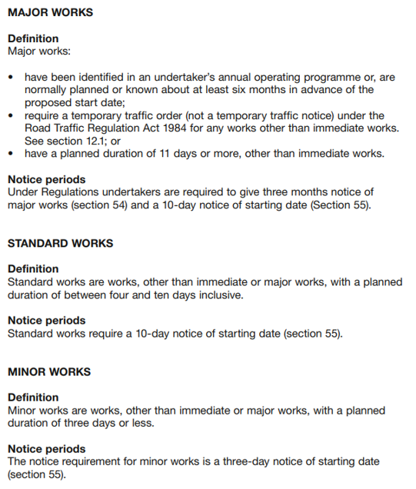
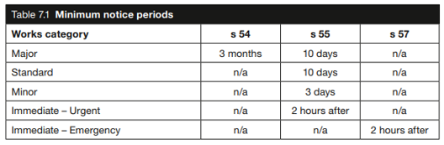
Why do they take less time than planned?
Works promoters have a time slot to work on the road dependent on the permit application. If everything goes to plan, then they will clear site, close the permit and register the reinstatement ahead of the proposed finish time. Streetworks inspectors are out in the network liaising with utilities and internal teams to ensure continuous efficiencies with regards to works cleared and closed, requesting permanent reinstatement first time.

Slide 30
Questions

